Slide 1
Intro to MongoDB
Lesson 17.1

Slide 2
What Is MongoDB?
MongoDB is a very popular noSQL database.
It uses a document-oriented model as opposed to a table-based relational model (SQL).
MongoDB stores data in BSON format (effectively, compressed JSONs).
MongoDB has tons of drivers and packages for connecting to Node, C++, Java, etc.
Masters of MongoDB

Slide 3
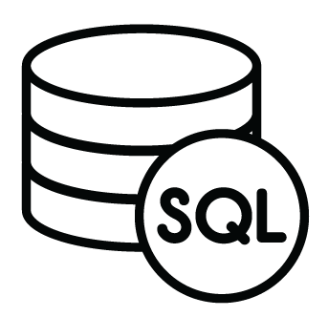
Relational Databases (SQL)
ID | Title | Author | Published
1 | The History of Blah | Blah Matic | 2010
2 | The Chronicles of Blahrnia | Sir Blahston | 2011
3 | Love in the Time of Blah | Gabriel Garcia Blah | 2013
SQL relies on joins to combine relevant data.
Author | Email | Phone Number
Blah Matic | blahston@gmail.com | 911-546-5454
Sir Blahston | blahby@gmail.com | 911-544-5112
Gabriel Garcia Blah | blahby231@gmail.com | 125-215-5645
Masters of MongoDB

Slide 4

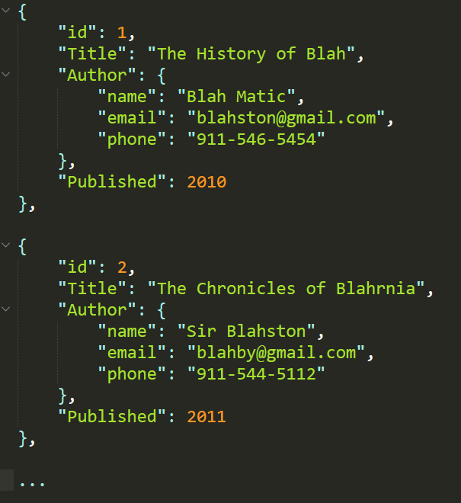
Document Database (noSQL)
noSQL databases, on the other hand, are effectively JSONs.
They excel at heterogeneous data formats and are easy to implement.
Masters of MongoDB

Slide 5
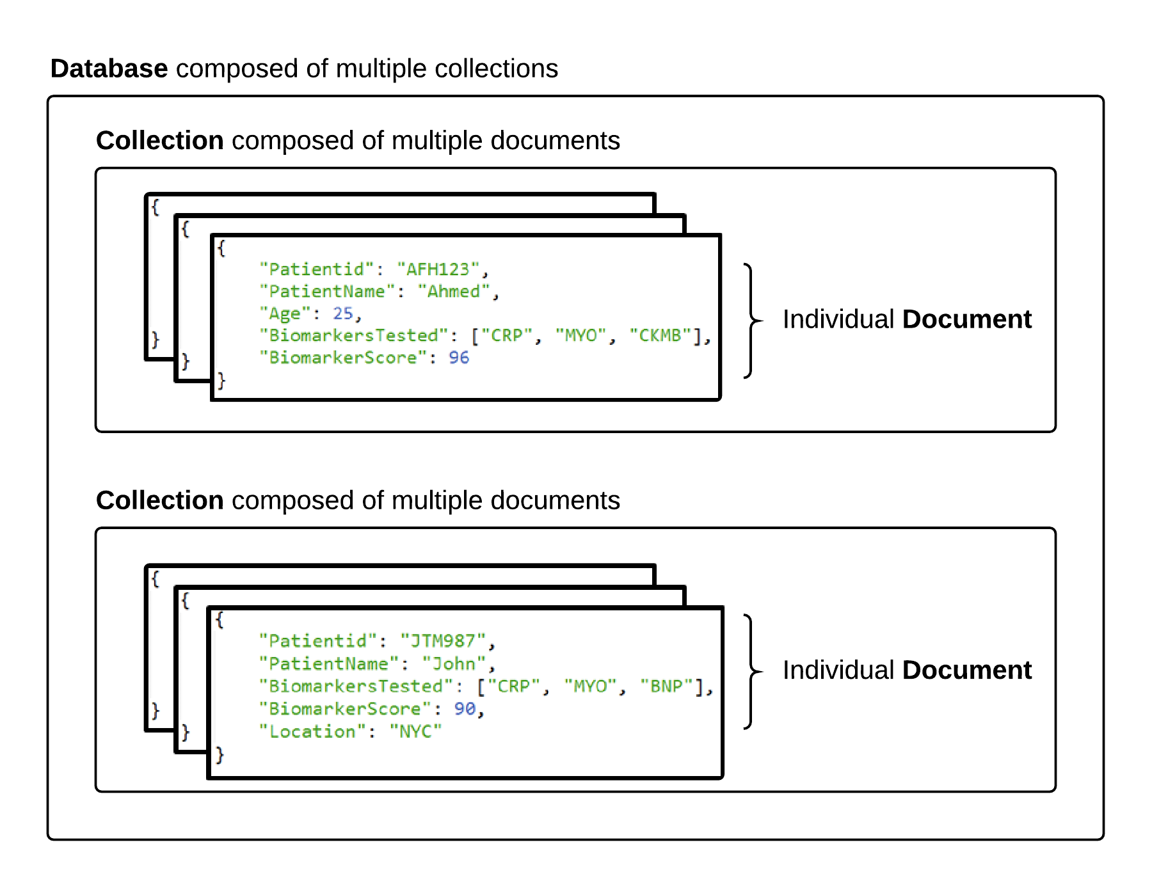
MongoDB Storage
Masters of MongoDB

Slide 6
MongoDB Terms
Take note! Terms are slightly different in the noSQL context.
SQL Term | noSQL Term
Database | Database
Table | Collection
Row | Document
Column | Field
Masters of MongoDB

